Slide 1
MUSIC GENRE CLASSIFICATION
LIKHITHA KYATHAM (190001032)
BHUVANA SREE PEDDAMALLU(190001046)
POOJA SREE PANAPAKALA(190001043)

Slide 2
ALGORITHMS USED
KNN
K-nearest neighbors algorithm is a type of supervised ML algorithm which can be used for both classification as well as regression predictive problems.
It uses ‘feature similarity’ to predict the values of new datapoints which further means that the new data point will be assigned a value based on how closely it matches the points in the training set.
CNN
Convolutional neural network is a multi-layered feed-forward neural network, made by assembling many unseen layers on top of each other in a particular order.
Technically, deep learning CNN models to train and test, each input image will pass it through a series of convolution layers with filters (Kernals), Pooling, fully connected layers (FC) and apply Softmax function to classify an object with probabilistic values between 0 and 1.

Slide 3
Dataset used
For this project, the dataset that we will be working with is GTZAN Genre Classification dataset which consists of 1,000 audio tracks, each 30 seconds long. It contains 10 genres, each represented by 100 tracks.
Our Datasets contains 10 genres :-
● Blues
● Classical
● Country
● Disco
● Hiphop
● Jazz
● Metal
● Pop
● Reggae
● Rock

Slide 4
Using KNN Algorithm

Slide 5
ACCURACY
No : of Nearest Neighbours Taken | Accuracy
2 | 64.246
5 | 68.907
10 | 65.909
20 | 64.306

Slide 6
Using CNN Algorithm

Slide 7
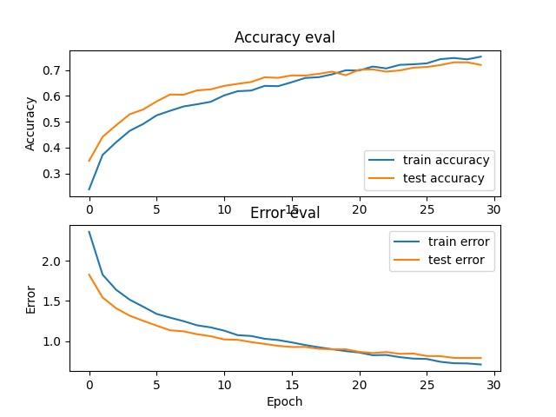
Plot for :- Layers = 3, drop out = 0.3 , learning rate = 0.00001, epochs = 30

Slide 8
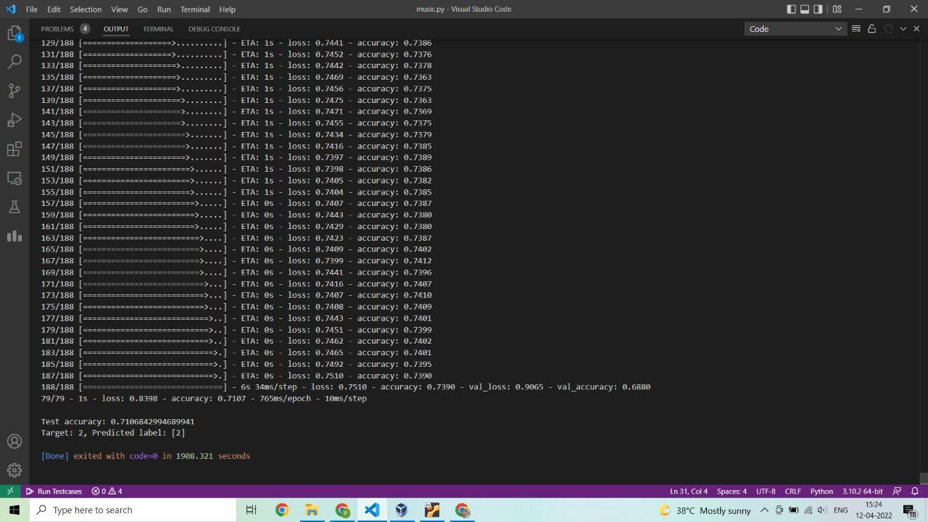

Slide 9
ACCURACY
No : of Convolutional Layers | Accuracy
2 | 70.35
3 | 71.06

Slide 10
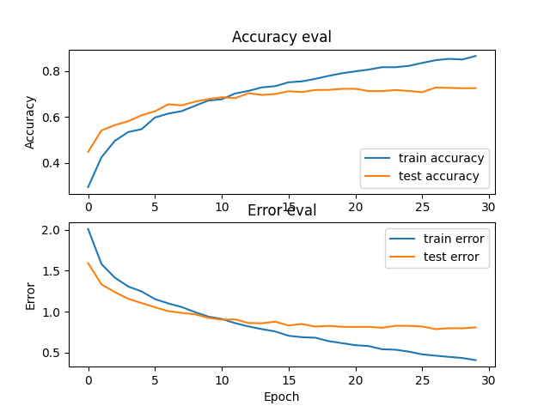
Plot for :- Layers = 2, drop out = 0.3 , learning rate = 0.00001, epochs = 30

Slide 11
ACCURACY
Drop out | Accuracy
0.3 | 71.06
0.25 | 72.94
0.35 | 71.74

Slide 12
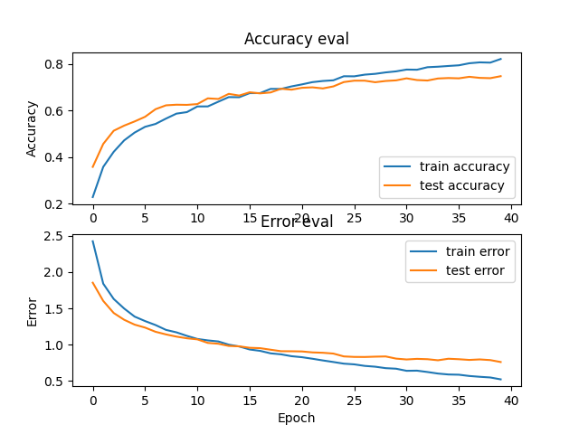
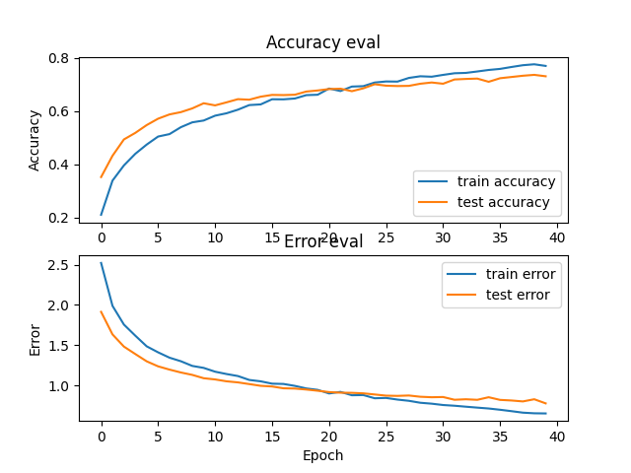
Plot for :- Layers = 3, drop out = 0.25 , learning rate = 0.00001, epochs = 30
Plot for :- Layers = 3, drop out = 0.35 , learning rate = 0.00001, epochs = 30

Slide 13
ACCURACY
Learning Rate | Accuracy
0.00001 | 71.06
0.00005 | 73.79

Slide 14
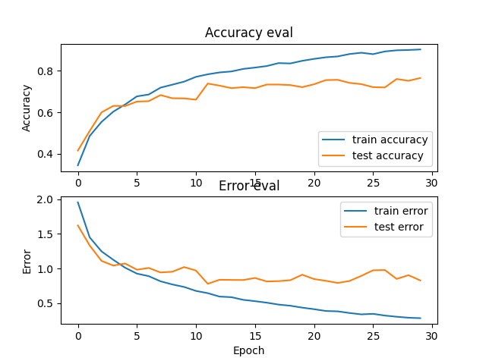
Plot for :- Layers = 3, drop out = 0.3 , learning rate = 0.00005, epochs = 30

Slide 15
ACCURACY
Epochs | Accuracy
30 | 71.06
25 | 69.50
35 | 71.74
40 | 74.62

Slide 16
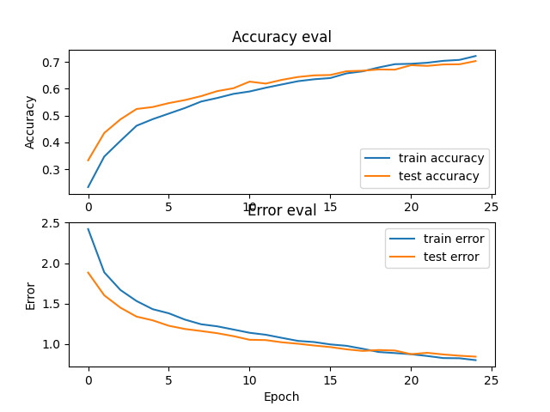
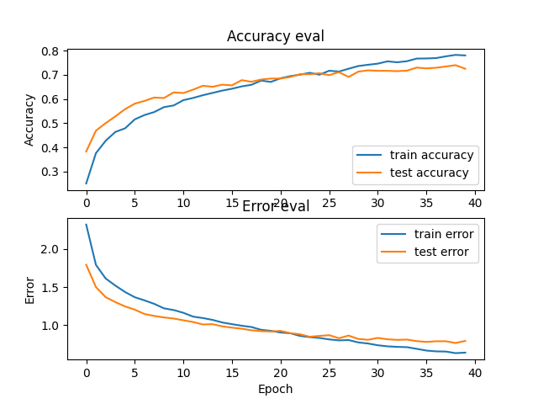
Plot for :- Layers = 3, drop out = 0.3 , learning rate = 0.00001, epochs = 25
Plot for :- Layers = 3, drop out = 0.3 , learning rate = 0.00001, epochs = 40

